Slide 1

Noam Sabag Bickel
Shay Bergman

Slide 2
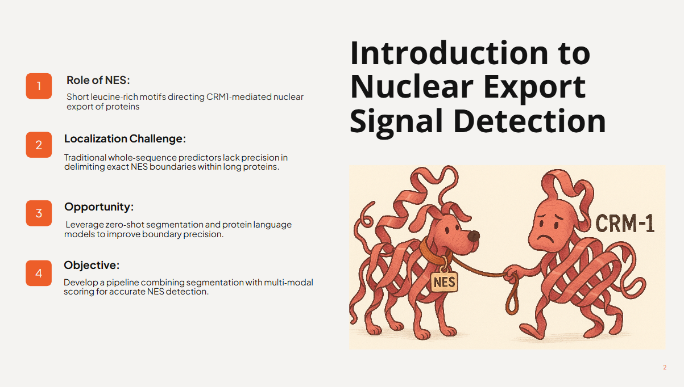

Slide 3
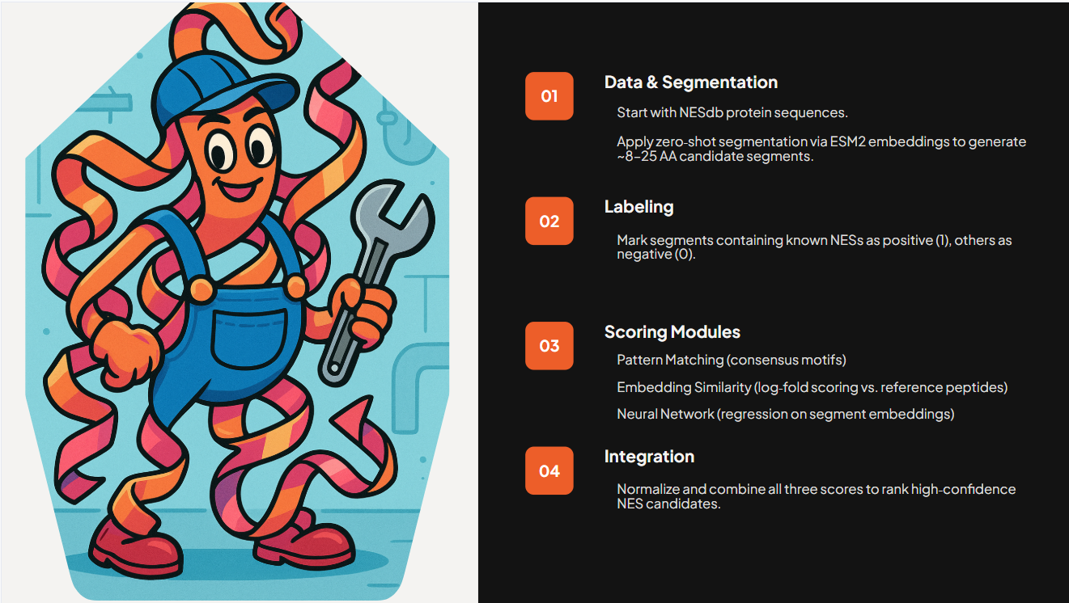
Pipeline Overview

Slide 4

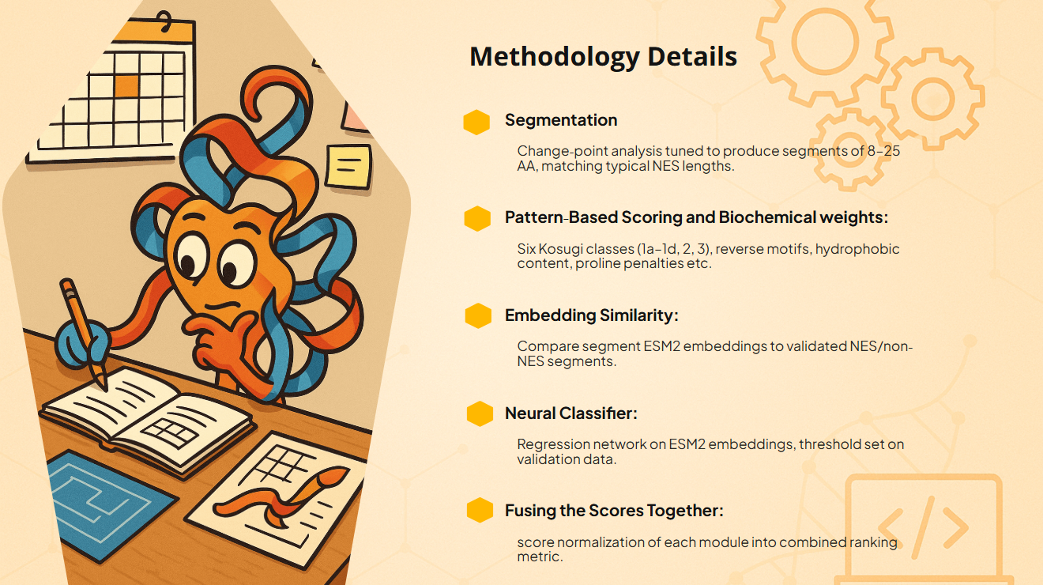
Methodology Details
Segmentation:
Change‐point analysis tuned to produce segments of (mostly) 8–25 AA, matching typical NES lengths.
Pattern‐Based Scoring and Biochemical weights:
Six Kosugi classes (1a–1d, 2, 3), reverse motifs, hydrophobic content, proline penalties etc.
Embedding Similarity:
Compare segment ESM2 embeddings to validated NES/non‐NES segments.
Neural Classifier:
Regression network on ESM2 embeddings, threshold set on validation data.
Fusing the Scores Together:
Score normalization of each module into combined ranking metric.

Slide 5

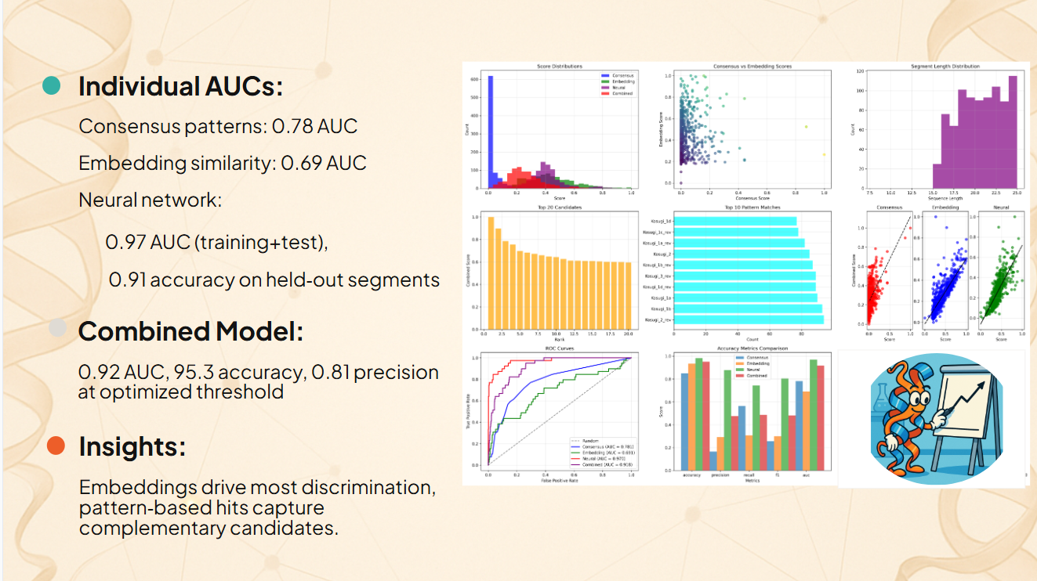
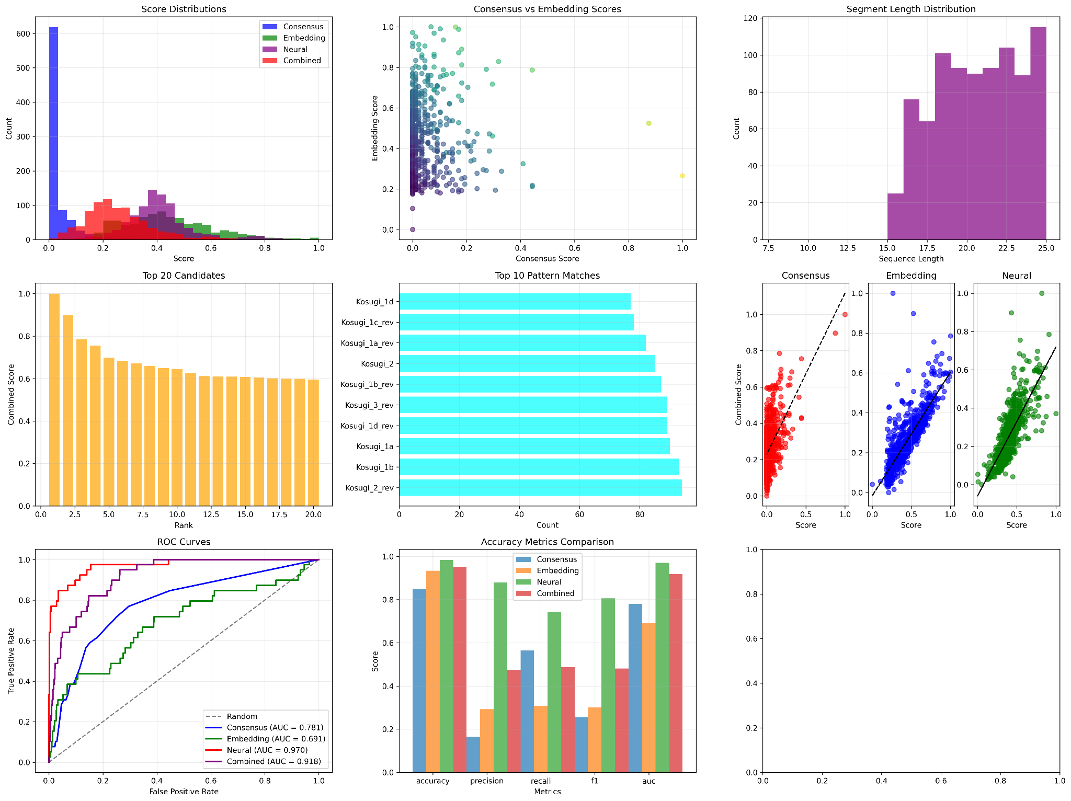
Key Results
Individual AUCs:
Consensus patterns: 0.78 AUC
Embedding similarity: 0.69 AUC
Neural network:
0.97 AUC (training+test),
0.91 accuracy on held‐out segments
Combined Model:
0.92 AUC, 95.3 accuracy, 0.81 precision at optimized threshold
Insights:
Embeddings drive most discrimination, pattern‐based hits capture complementary candidates.

Slide 6

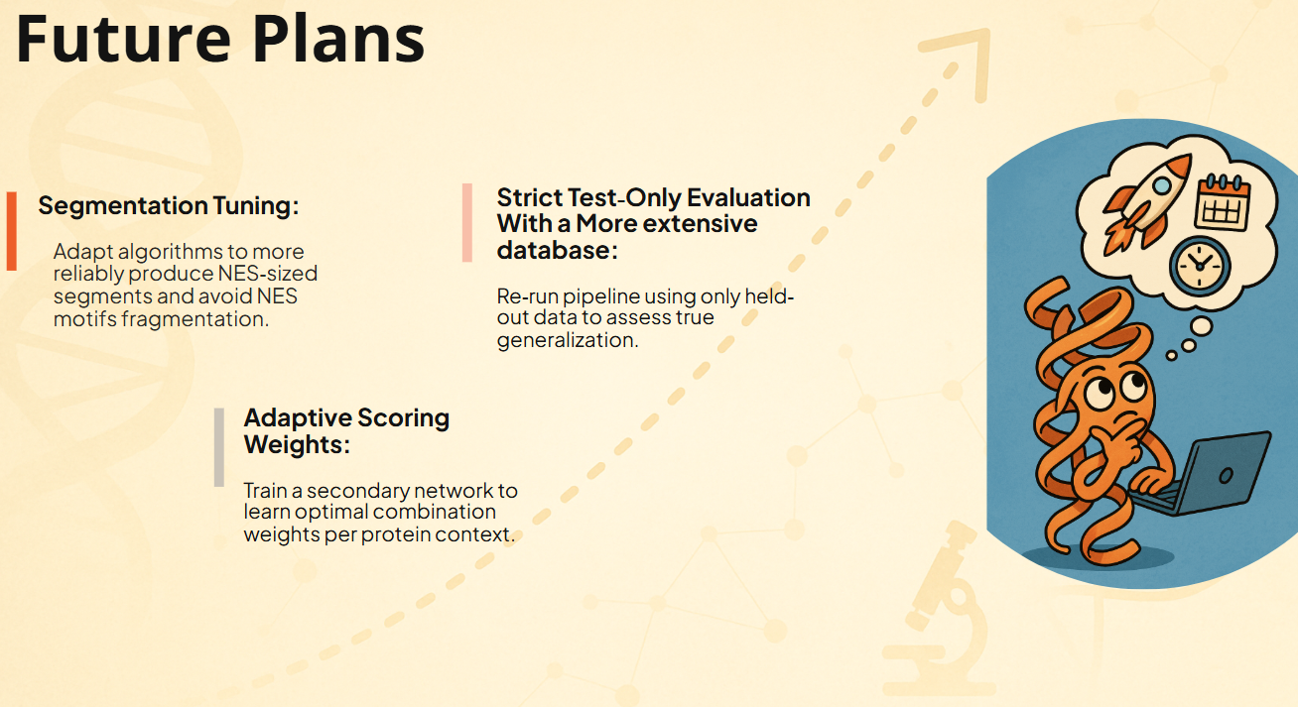
Future Plans
Segmentation Tuning:
Adapt algorithms to more reliably produce NES‐sized segments and avoid NES motifs fragmentation.
Adaptive Scoring Weights:
Train a secondary network to learn optimal combination weights per protein context.
Strict Test‐Only Evaluation With a More extensive database:
Re‐run pipeline using only held‐out data to assess true generalization.
Framework Expansion:
Apply zero‐shot + multi-modal approach to discover other short functional motifs in proteomes.

Slide 7


